Slide 1
Can we predict feature of a stock ?
An attempt to come up with a better model for the Financial Forecasting Challenge organized by G-Research worth $30,000
Jithin J Kumar
Cohort-9
Individual Project

Slide 2
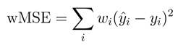
The Challenge
Data Set with 623,759 observations and 16 features were provided. Size of dataset (623759 x 16)
Aim :- To come up with a model that accurately predicts the value in column ‘y’.
Evaluation of our Model :
Based on Weighted MSE formula as below.

Slide 3
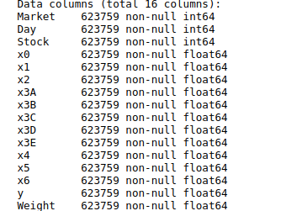
The Data Exploration
3 categorical features -
Market,
Day
Stock.
11 continuous features
2 Result Features
Y
Weight
X0 | X3A | X3D | X5
X1 | X3B | X3E | X6
X2 | X3C | X4

Slide 4
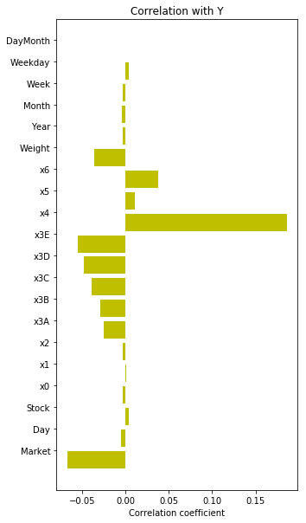
Feature Study or Feature Selection
From the Feature Day, we were able to assume (assign) week day, Week, Month. The intuition was to derive meaningful representation of data.
Inference :
X4 has comparatively high correlation with Y followed by X3E,X3D,X3C,X6,X3B,X3A,X2 (however they have a negative correlation)

Slide 5
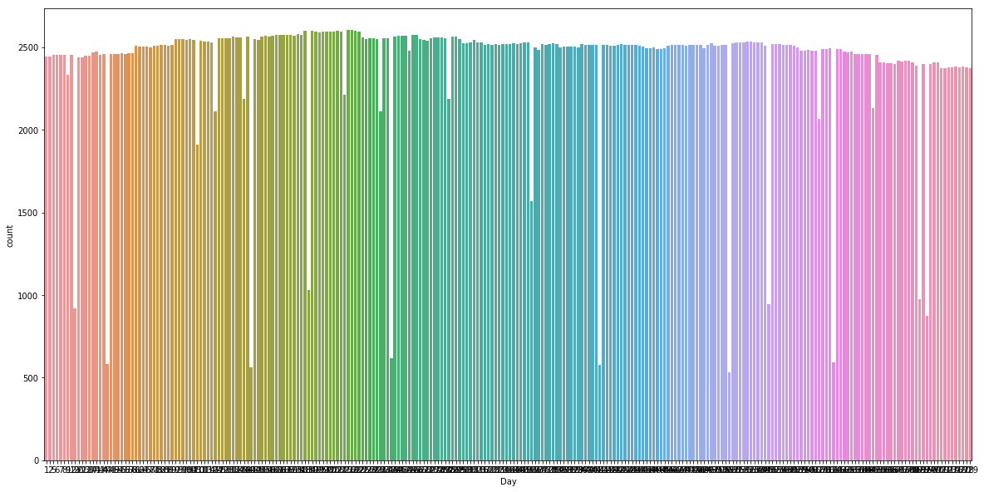
Count Plot of Day
Inference : We don't have data of all the days. The White gap shows that some days we have data of less number of stocks. (Probably this gap would be the test data)

Slide 6
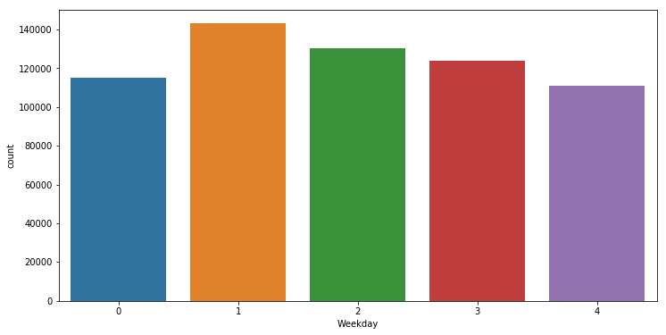
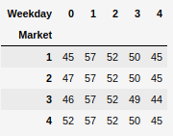
Feature Study : WeekDay
0-Monday, 1- Tuesday, 2- Wednesday, 3-Thursday, 4- Friday
We have more number of observations on Tuesday. Graph shows uneven distribution. The data consist of roughly 57 Tuesdays or just a little over 1 year of stock data.

Slide 7
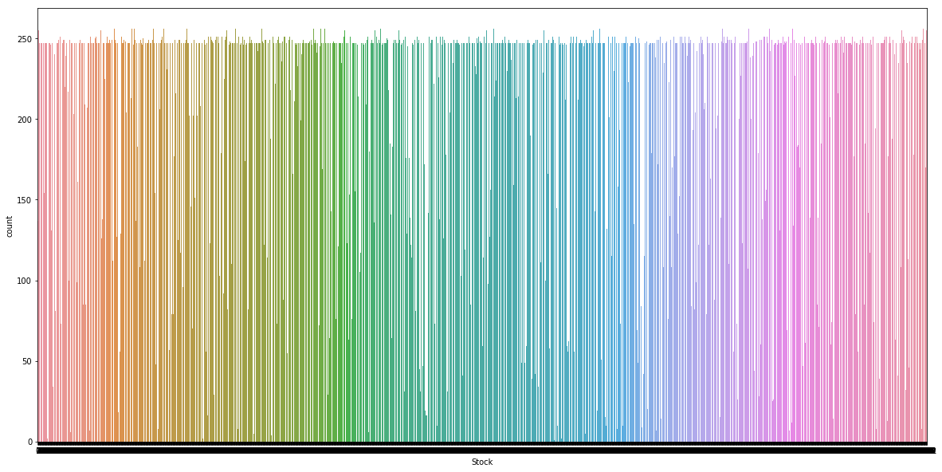
Count Plot of Stock
Again the White gaps would be the test Data. and our training dataset has almost all the stocks with 240 observations per each stock.

Slide 8
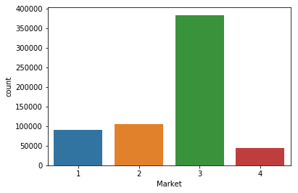
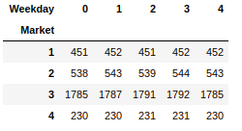
Feature Study : Market
Our training data predominantly contains observations with Market Feature as 3. The Table shows the number of stocks in each weekday and market. Consistent to our observation Market 3 has 1792 Stocks while Market 1 has 452,Market2 has 544 and Market 4 has 231 stocks. Same stock is being repeated in multiple markets.

Slide 9
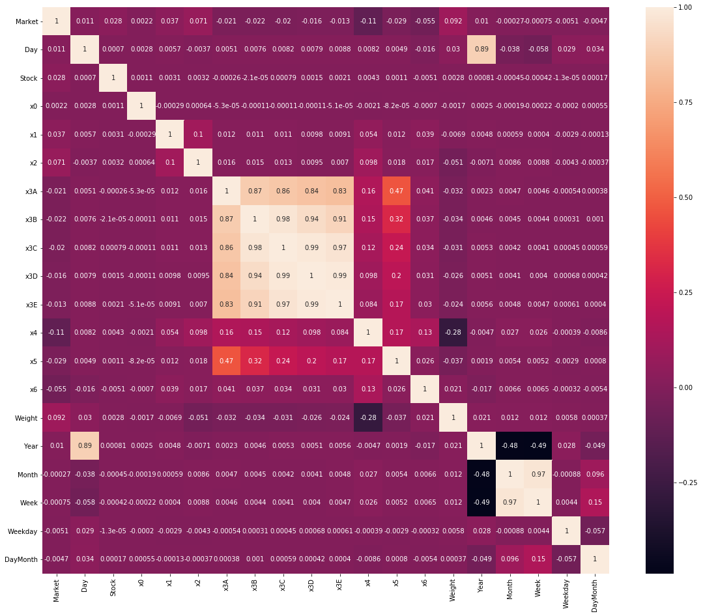
Feature Analysis
Continuous
Variables
Corelation Heat Map.
There seems to be some positive relation between x3a, x3b,x3c,x3d,x3e and minor relation with x5.
This is inferred from the colour differences.

Slide 10
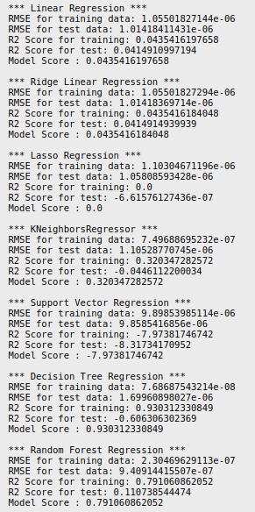
Evaluating Models
Clear Winner here is Decision Tree Classifier. With a good r2 fit. Close to .93
Random Forest Regression without tuning gives a fit of .79.
Lets work more on this model and tune it.

Slide 11
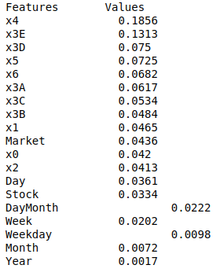
Feature Importance...
Identifying the important features
X4 appears to be the most important feature.
Followed by X3E,X3D,X5,X6.
Important fact was Day and WeekDay was not at all an important feature. Unlike my first assumption and Exploratory Data Analysis.
Hence the idea that we used during the Exploratory Data Analysis part had to be taken off.

Slide 12
Arriving at the Best Model….
So the main aspect of this project is to arrive at the best model that reduces the error.
From our preliminary Examination we figured out Tree based models were giving a better predictions hence i decided to work on the more reliable Tree based models like Random Forest, XG Boost and Light GBM.

Slide 13
Testing Our Models.
Random Forest gave an Error Value of - 0.17525
XG-Boost gave an Error Value of - 4.132 (which is quite high (over fitting)
Light GBM gave an Error Value of - .15099
…..So the Clear Winner Here is Light GBM model

Slide 14
Result Interpretation
Ok so now how my model would have performed against the original dataset. ?
Original Test Dataset is approx twice the size of my test data. Hence we can safely assume the error score would have increased (approx twice) if i were to test this model with the original test datatest.
So my final model weighted error value would have been (.30 -31 range)

Slide 15
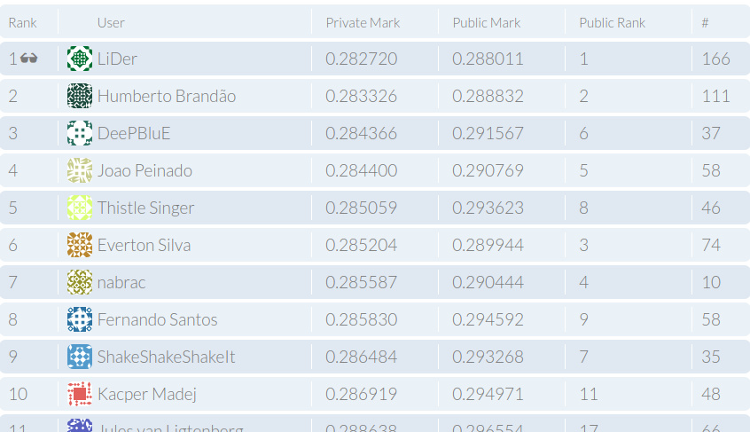
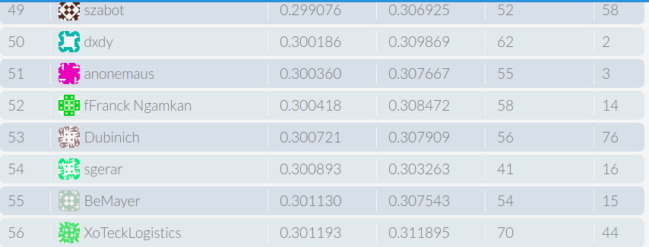
Final Leaderboard
My Score would have fetched me somewhere between 50 -100

Slide 16
Resources Used
Forecasting Challenge Website - https://financialforecasting.gresearch.co.uk/
Github Resources that helped me on this project
https://github.com/unnir/g_research_financial_forecasting_challenge
https://medium.com/@samuel.monnier/notes-on-the-g-research-competition-91e691e9dbd7
https://github.com/sam31415/G-Research-financial-forecasting-challenge
https://github.com/bukosabino/financial-forecasting-challenge-gresearch
https://medium.com/@bukosabino/financial-forecasting-challenge-by-g-research-8792c5344ae9

Slide 17
Thank you
Mentors,
Uday Keith
Anagha Sharma
Special Mention to Ravi, Kiran, Lakshmi and Sanoj and others for the support provided during the bootcamp.

